Slide 1
Face Mask Detection
BY
Akanksha more
Mansi Todmal

Slide 2
Background
The spread of COVID-19 is increasingly worrying for everyone in the world. This virus can be affected from human to human through the droplets and airborne.
According to the instruction from WHO, to reduce the spread of COVID-19, every people need to wear face mask, do social distancing, evade the crowd area and also always maintain the immune system.
Therefore, to protect each other, every person should wear the face mask properly when they are in outdoor. However, most of selfish people won’t wear the face mask properly with so many reasons.

Slide 3
Introduction
To overcome this situation, a robust face mask detection needs to be developed. In order to detect a face mask, the object detection algorithm can be implemented.
During pandemic COVID-19, WHO has made wearing masks compulsory to protect against this deadly virus. In this project we will develop Application – Real-time Face Mask Detector with Android Studio.
We will build a real-time system to detect whether the person on the webcam is wearing a mask or not.

Slide 4
Objectives
To study face detection and recognition techniques.
To design a system that can detect and recognize faces in real time.
Simulate the algorithms and obtain the result using different machine learning concepts such as tensorflow , opencv , etc using android.

Slide 5
Features of project
Can identify multiple faces in real time.
Uses a stored database of faces.
Is robust and not much affected by light.
Automatically starts the camera of smartphones and detects the faces.

Slide 6
Project specifications
System requirements :-
Android Studio
Java Virtual Machine
Any OS (64-bit)
4 GB RAM minimum, 8 GB RAM recommended
2 GB of available disk space minimum, 4 GB Recommended (500 MB for IDE + 1.5 GB for Android SDK
1280 x 800 minimum screen resolution

Slide 7
Concepts used :-
Machine learning
Deep learning
Tensorflow Lite
Requirements:-
Dataset :-The majority of the images were augmented by OpenCV. The set of images were already labelled “mask” and “no mask”. The images that were present were of different sizes and resolutions, probably extracted from different sources or from machines (cameras) of different resolutions.

Slide 8
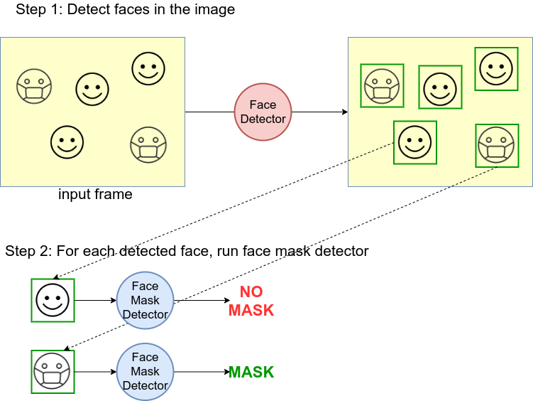

Slide 9
What are going to Design
A solution that is within everyone’s reach could help to control the use of the face mask. And today everyone has a smartphone, so perhaps a mobile application could help. This post solves this problem using an Android mobile application that recognizes face masks.
So here I’ve developed an application to detect face masks in the smartphone. This application works in real time.

Slide 10
How we are going to implement
today everyone has a smartphone, so perhaps a mobile application could help. This post solves this problem using an Android mobile application that recognizes face masks
The approach to utilize a two-stages detector, first a face detector is applied, to retrieve the faces positions. Then each face is cropped and prepossessed to be feed into the second model which does a binary classification detecting between “mask” or “no-mask”.
We use Android Studio to Develop this application .

Slide 11
Benefits to society and us
Masks are a key measure to suppress transmission and save lives.
Masks should be used as part of a comprehensive ‘Do it all!’ approach including physical distancing, avoiding crowded, closed and close-contact settings, good ventilation, cleaning hands, covering sneezes and coughs, and more.
We developed the face mask detector model for detecting whether person is wearing a mask or not.
This is a nice project for beginners to implement their learnings and gain expertise.

Slide 12
Future Scope
There are a number of aspects we plan to work on shortly :
Currently, the model gives 5 FPS inference speed on a CPU. In the future, we plan to improve this up to 15 FPS, making our solution deployable for CCTV cameras, without the need of a GPU.
The use of Machine Learning in the field of mobile deployment is rising rapidly. Hence, we plan to port our models to their respective TensorFlow Lite versions.
Our architecture can be made compatible with TensorFlow RunTime (TFRT), which will increase the inference performance on edge devices and make our models efficient on multithreading CPUs.

Slide 13
References
S. Wang Chen, Horby Peter W, Hayden Frederick G, Gao George F. A novel coronavirus epidemic of global concern for health. It's the Lancet. 2020;395(10223):470-473. 10.1016 / S0140-6736(20)30185-9.
Matrajt L, Leung T. Evaluating the efficacy of social distancing strategies to postpone or flatten the curve of coronavirus disease. Emerg Infect Dis, man. 2020:
Chen, S., Zhang, C., Dong, M., Le, J., R., M., 2017b. Using rankingcnn for age estimates, in: IEEE Conference on Computer Vision and Pattern Recognition (CVPR)
Sandler, Mark, Andrew Howard, Menglong Zhu, Andrey Zhmoginov, and Liang-Chieh Chen, "Mobilenetv2: Inverted residues and linear bottlenecks," IEEE
C.Fu, W.Liu, A.Ranga, A. Tyagi, A. Berg, "DSSD: deconvolutional single shot detector model," arXiv preprint arXiv:1701.06659, (2017)
Lin, Tsung-Yi, Piotr Dollár, Ross Girshick, Kaiming He, Bharath Hariharan, and Serge Belongie, "Type Pyramid Networks for Object Detection," IEEE

Slide 14
Thank You

